Slide 1
English 2nd Paper Class: Six Time: 40 minutes.

Slide 2
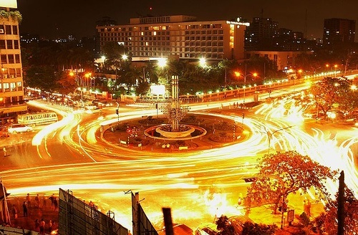
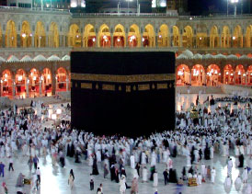
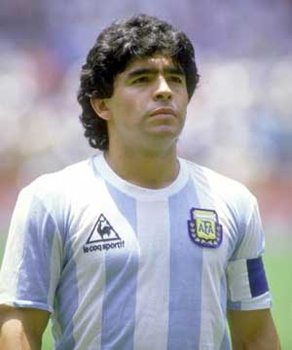
Dhaka
Mecca
Noun
Diego Maradona
Television

Slide 3
Noun

Slide 4
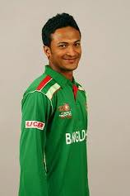
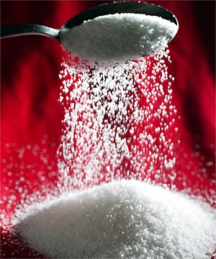
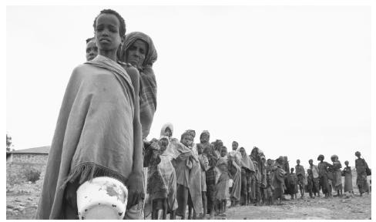
A Noun is the name of
anything.
Sakib-al-Hasan
Suger
Poverty

Slide 5
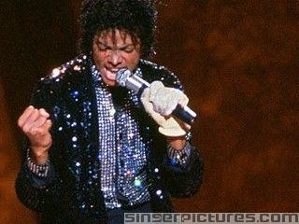
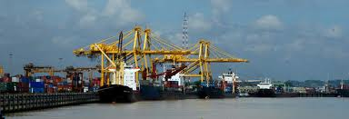
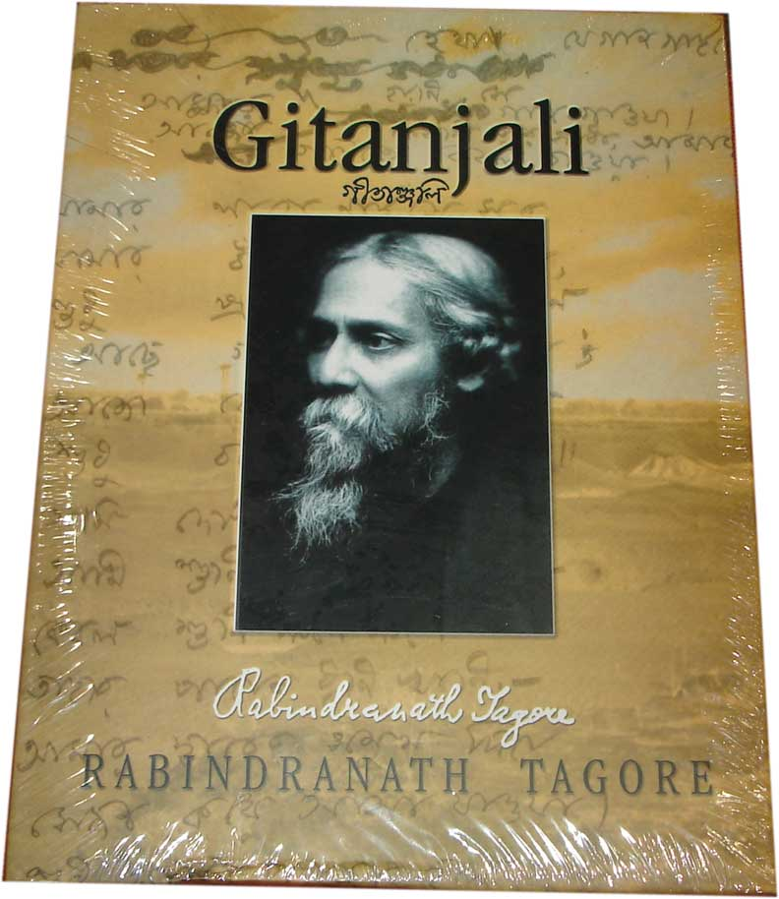
Proper Noun
Michel Jackson
Seaport
Gitanjali
A noun belonging to the class of words used as names for unique individuals, events, or places.

Slide 6
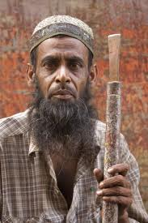
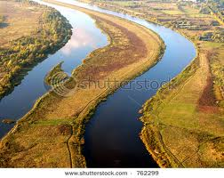
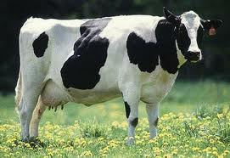
Common Noun
Man
River
Cow
Book
A noun that can be preceded by the definite article (the) and that represents one or all of the members of a class.

Slide 7
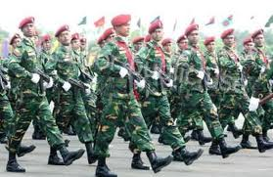
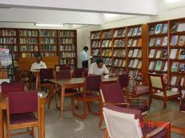
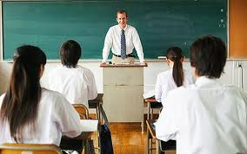
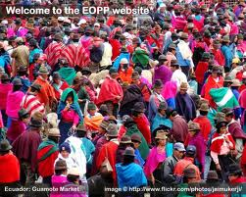
Collective Noun
ARMY
LIBRARY
CLASSROOM
CROWD
A noun (such as team, committee, or family) that refers to a group of individuals.

Slide 8
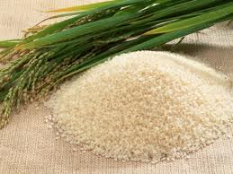
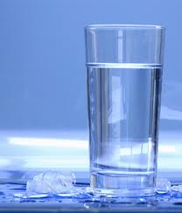
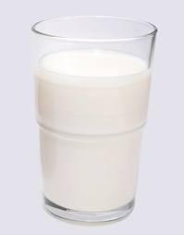
Material Noun
RICE
SUGER
WATER
MILK
A material noun is a name of a substance as a whole.

Slide 9
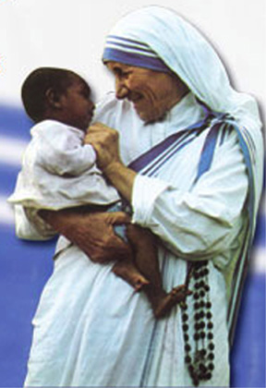
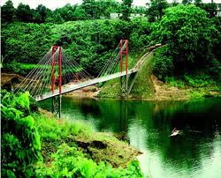
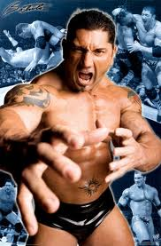
Abstract Noun
An abstract noun is a word used to describe intangible concept such as states events, concepts that power, kindness, love, beauty, poverty etc.
Beauty
Love
Poverty
Power

Slide 10
Noun
Proper Noun
Common Noun
Collective Noun
Material Noun
Abstract Noun

Slide 11
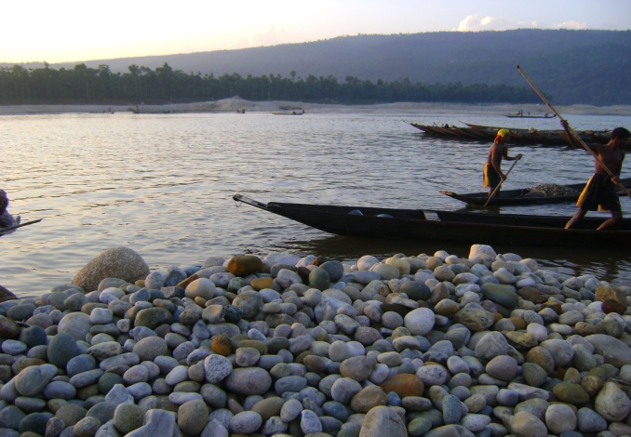
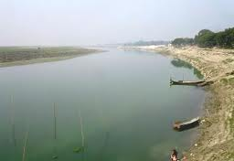
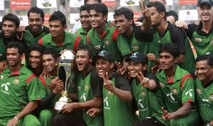
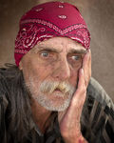
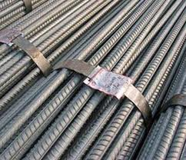
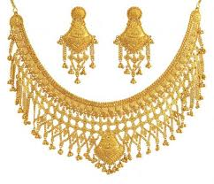
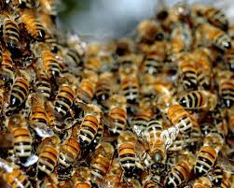
Group Work
See the pictures and name them. Then say which nouns they belong to:
Team
Scenery
River
Insect
Anxisity
Iron
Gold
Love

Slide 12
Home Work
Identify the Nouns of the underlined words.
1. Honesty is the best policy.
2. Iron is a useful metal.
3. I met him in the party.
4. The boy is meritorious.
5. Hongkong is a big city.

Slide 13
By
Md. Faridul Alam
Senior Teacher
Navy School & College Chittagong
Thank you.

